Slide 1

Advanced Visualization Tools

Slide 2
Objectives
Apply advanced visualization tools to create waffle charts
Create word clouds.
Use Seaborn with Matplotlibto generate attractive regression plots.
Advanced Visualization Tools

Slide 3
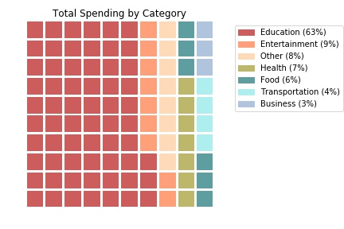
Waffle Charts
What is a waffle chart?
  A waffle chart is a great way to visualize data in relation to a whole or to highlight progress against a given threshold.
  A waffle chart is an interesting visualization that is normally created to display progress toward golds
Advanced Visualization Tools

Slide 4
Waffle Charts
Question: immigration from Scandinavia to Canada is comprised only of immigration from Denmark, Norway, and Sweden, and we're interested in visualizing the contribution of each of these countries to the Scandinavian immigration to Canada.
→ student give the opinions
Advanced Visualization Tools

Slide 5
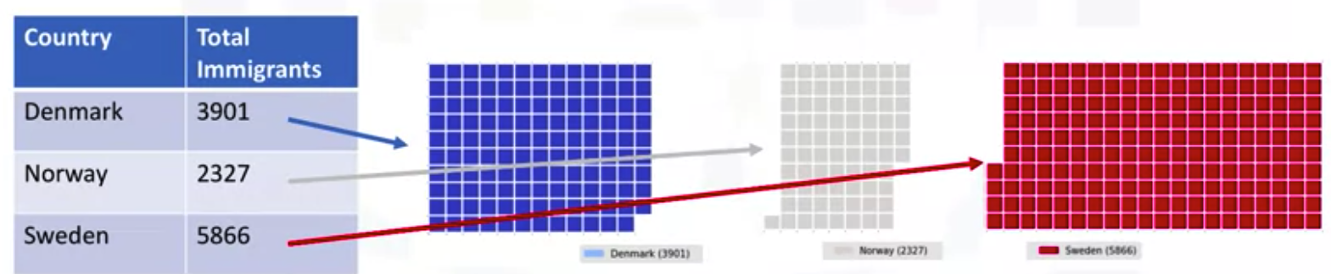
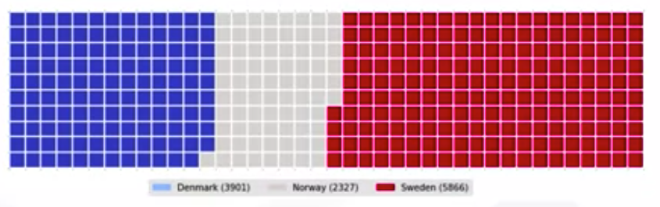
Waffle Charts
Matplotlib does not have a built-in function to create waffle charts.
Advanced Visualization Tools

Slide 6
Word Clouds
What is a word cloud?
  A word cloud is simply a depiction of the importance of different words in the body of text.
The more a specific word appears in a source of textual data the bigger and bolder it appears in the world cloud.
Advanced Visualization Tools

Slide 7
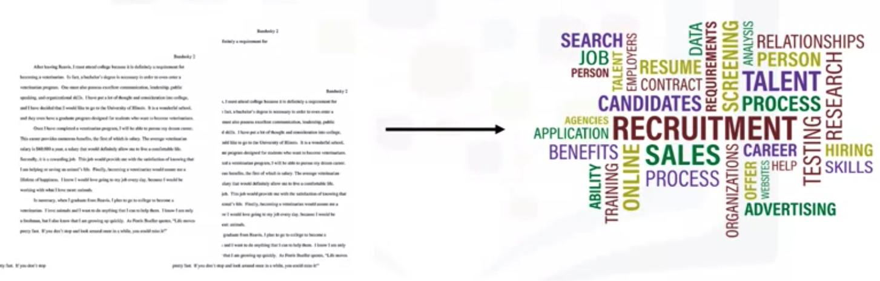
Word Clouds
So given some text data on recruitment, for example, we generate a cloud of words like this. This cloud is telling us that words such as recruitment, talent, candidates, and so on, are the words that really stand out in these text documents.
Advanced Visualization Tools

Slide 8
Word Clouds
Matplotlib does not have a built-in function to generate word clouds. However, luckily a Python library for cloud word generation that was created by Andreas Mueller is publicly available
Advanced Visualization Tools

Slide 9
Word Clouds
The dataset used for generating word cloud is collected from UCI Machine Learning Repository. It consists of YouTube comments on videos of popular artists.
Dataset Link : https://archive.ics.uci.edu/ml/machine-learning-databases/00380/
Advanced Visualization Tools

Slide 10
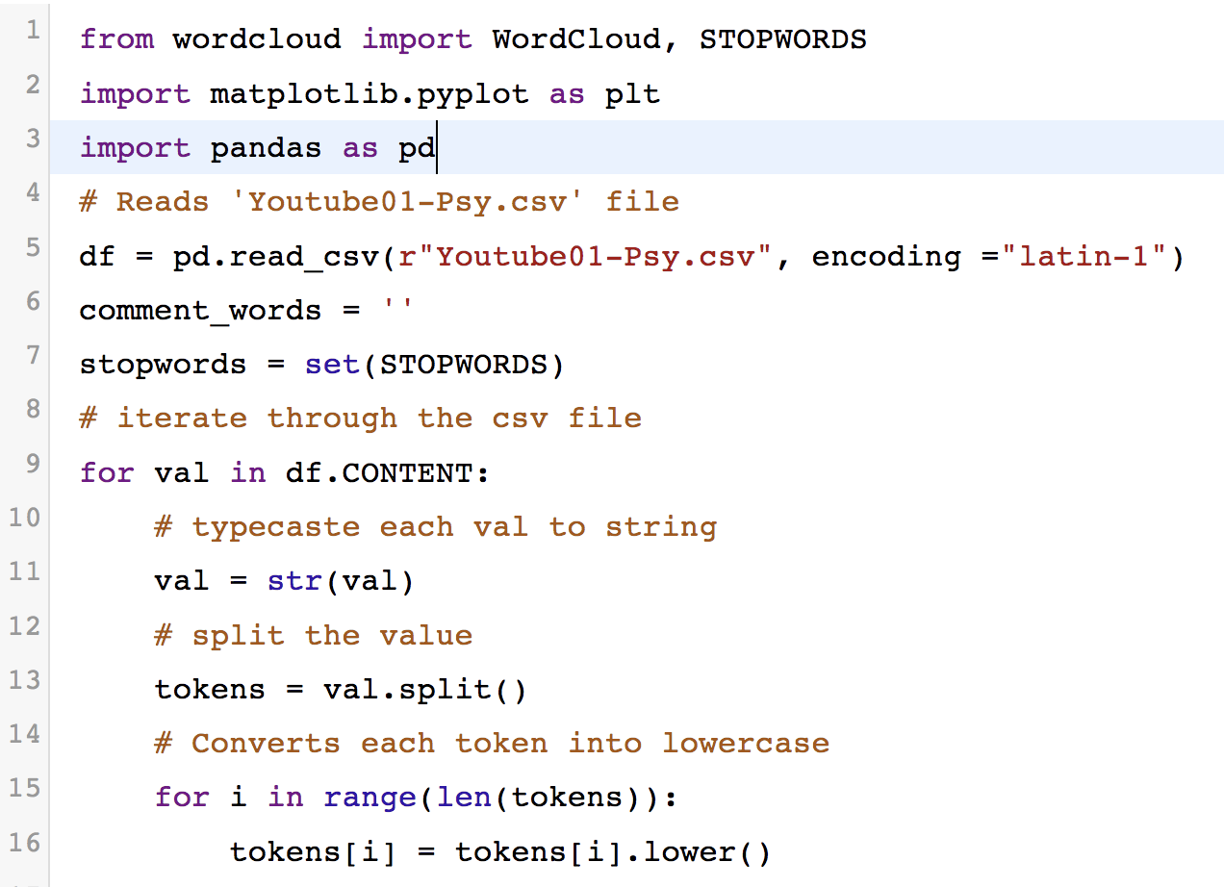
Word Clouds
Advanced Visualization Tools

Slide 11
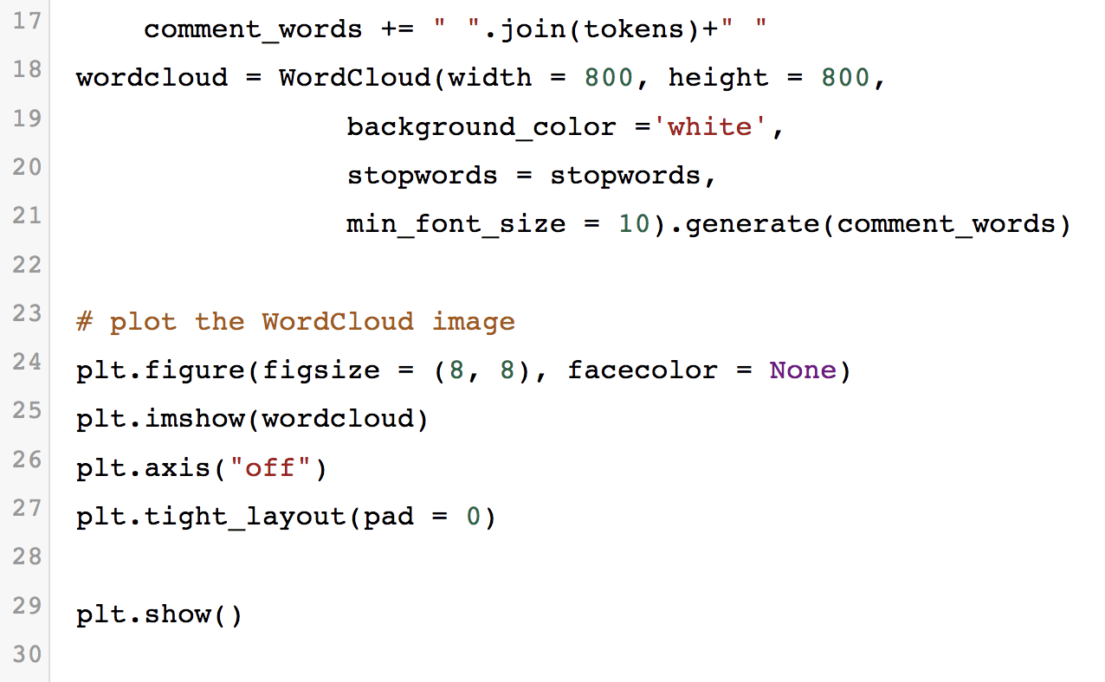
Word Clouds
Advanced Visualization Tools

Slide 12
Seaborn and Regression Plots
Seaborn is another data visualization library.
It is actually based on Matplotlib. It was built primarily to provide a high-level interface for drawing attractive statistical graphics, such as regression plots, box plots.
Seaborn can generate plots with code that is 5 times less than with Matplotlib.
Advanced Visualization Tools

Slide 13
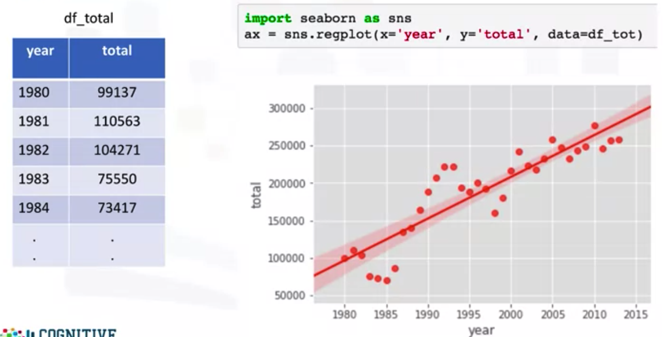

Seaborn and Regression Plots
Creating a scatter plot along with a regression line to highlight any trends in the data.
Advanced Visualization Tools

Slide 14
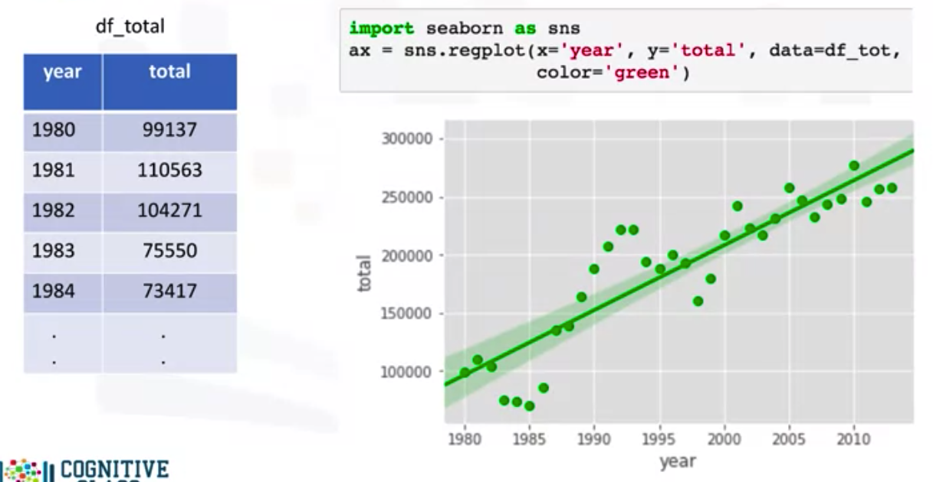
Seaborn and Regression Plots
Advanced Visualization Tools

Slide 15
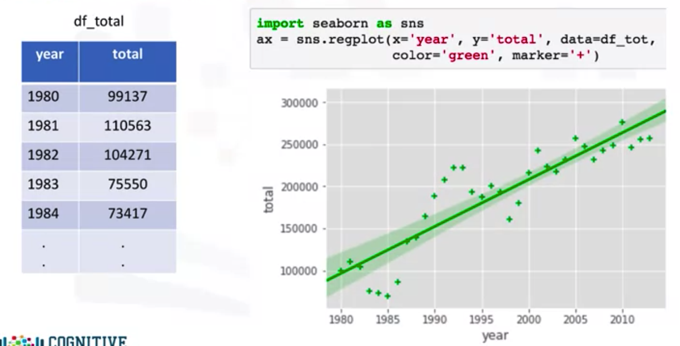
Seaborn and Regression Plots
Advanced Visualization Tools

Slide 16
Summary
Apply advanced visualization tools to create waffle charts
Create word clouds.
Use Seaborn with Matplotlibto generate attractive regression plots.
Advanced Visualization Tools

Slide 17
Q & A
Advanced Visualization Tools

